Slide 1



Automated Reasoning about Software ($67532$)
Guy Katz
Lecture $11$: Linear Programming (LP) January $6$^{th}, $2020$

Slide 2
Acknowledgements
Some of the material presented has been borrowed from slides by David Dill, Isil Dillig, Gera Weiss, Clark Barrett, Alex Aiken, Mooly Sagiv, Sagar Chaki and Ofer Strichman

Slide 3
Overview
Previous topics:
Boolean satisfiability (SAT) solvers
Satisfiability Modulo Theories (SMT) solvers
SMT solvers can be used to solve arithmetic problems
Linear programs (LPs) are a particularly interesting class of arithmetic problems, with standalone solvers
Many interesting applications, including to neural network verification

Slide 4
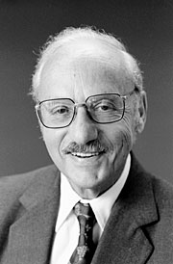
Historical Context
Linear programming emerged during and after WW2
Motivation: optimizations for army supplies and planning problems
Mostly associated with George Dantzig, who also invented the famous Simplex algorithm for solving them
Although others also involved: Kantorovich, von Neumann
LP and Simplex still used extensively, many mature tools exist

Slide 5
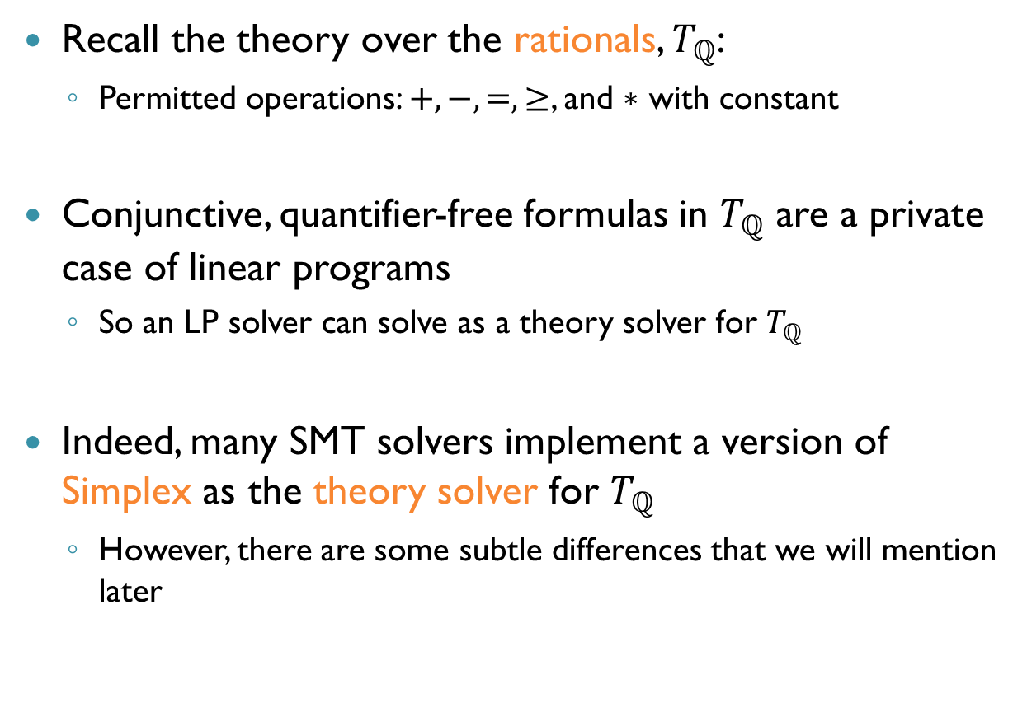
Linear Programming and SMT
Recall the theory over the rationals, $T_{ℚ}$:
Permitted operations: $+,−,=,≥$, and $∗$ with constant
Conjunctive, quantifier-free formulas in $T_{ℚ}$ are a private case of linear programs
So an LP solver can solve as a theory solver for $T_{ℚ}$
Indeed, many SMT solvers implement a version of Simplex as the theory solver for $T_{ℚ}$
However, there are some subtle differences that we will mention later

Slide 6
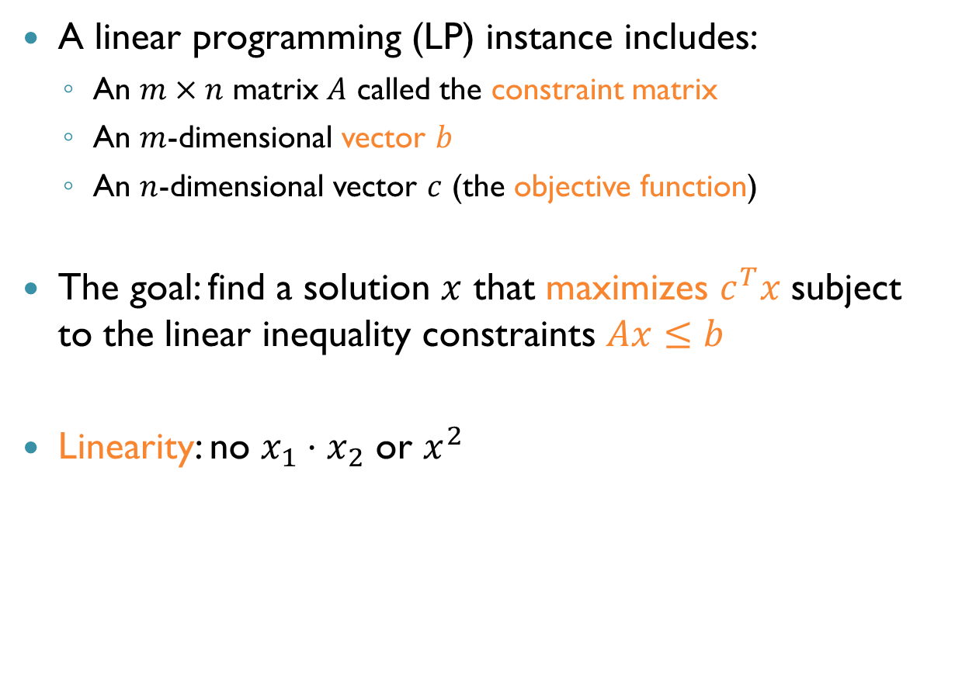
Linear Programming
A linear programming (LP) instance includes:
An $m×n$ matrix $A$ called the constraint matrix
An $m$-dimensional vector $b$
An $n$-dimensional vector $c$ (the objective function)
The goal: find a solution $x$ that maximizes $c^{T}x$ subject to the linear inequality constraints $Ax≤b$
Linearity: no $x_{1}⋅x_{2}$ or $x^{2}$

Slide 7

Example and Lingo
Maximize $2x_{2}−x_{1}$ subject to: $x_{1}+x_{2}≤3$
$$2x_{1}−x_{2}≤−5$$
Here:
$$x=\left[\begin{aligned}x_{1} \\ x_{2}\end{aligned}\right] A=\left[\begin{matrix}1 & 1 \\ 2 & −1\end{matrix}\right] b=\left[\begin{aligned}3 \\ −5\end{aligned}\right] c=\left[\begin{aligned}−1 \\ 2\end{aligned}\right]$$
Find $x$ that maximizes $c^{T}x$, subject to $Ax≤b$

Slide 8
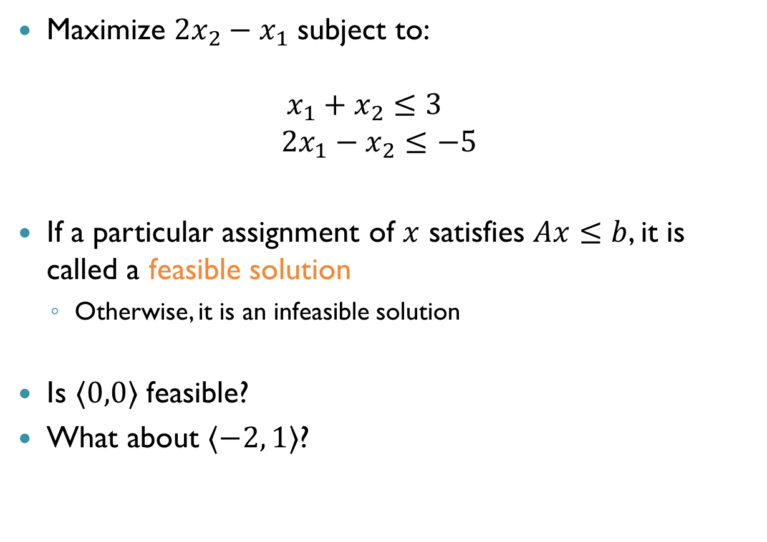
Example and Lingo (cnt’d)
Maximize $2x_{2}−x_{1}$ subject to: $x_{1}+x_{2}≤3$
$$2x_{1}−x_{2}≤−5$$
If a particular assignment of $x$ satisfies $Ax≤b$, it is called a feasible solution
Otherwise, it is an infeasible solution
Is $〈0,0〉$ feasible?
What about $〈−2, 1〉$?
No
Yes

Slide 9
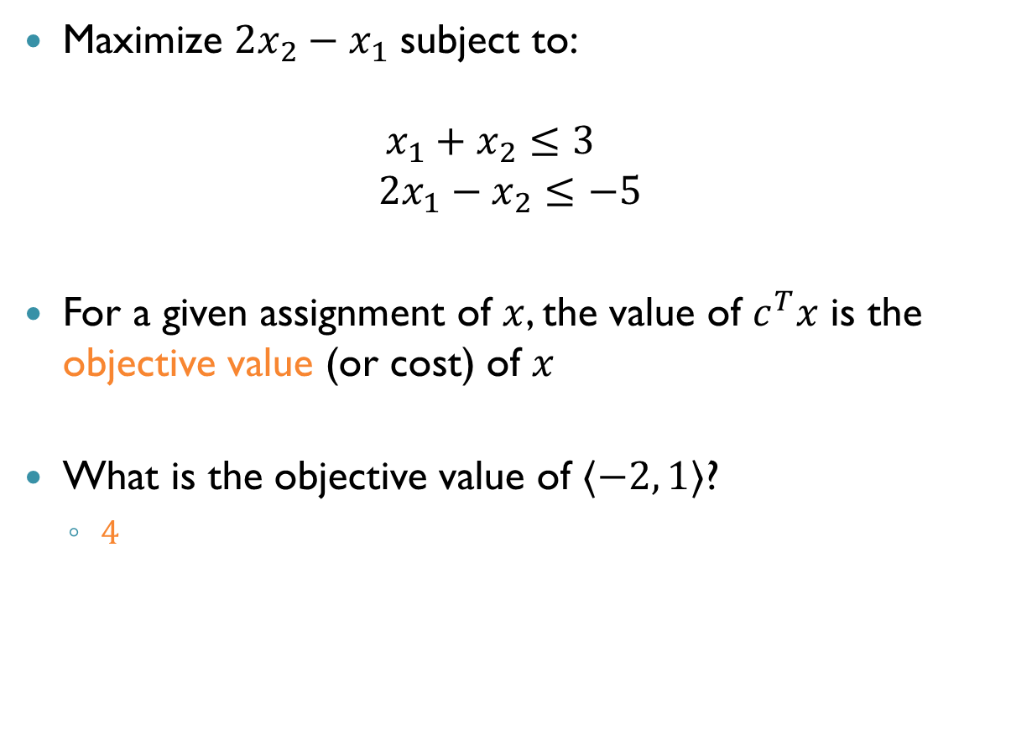
Example and Lingo (cnt’d)
Maximize $2x_{2}−x_{1}$ subject to: $x_{1}+x_{2}≤3$
$$2x_{1}−x_{2}≤−5$$
For a given assignment of $x$, the value of $c^{T}x$ is the objective value (or cost) of $x$
What is the objective value of $〈−2, 1〉$?
$4$

Slide 10
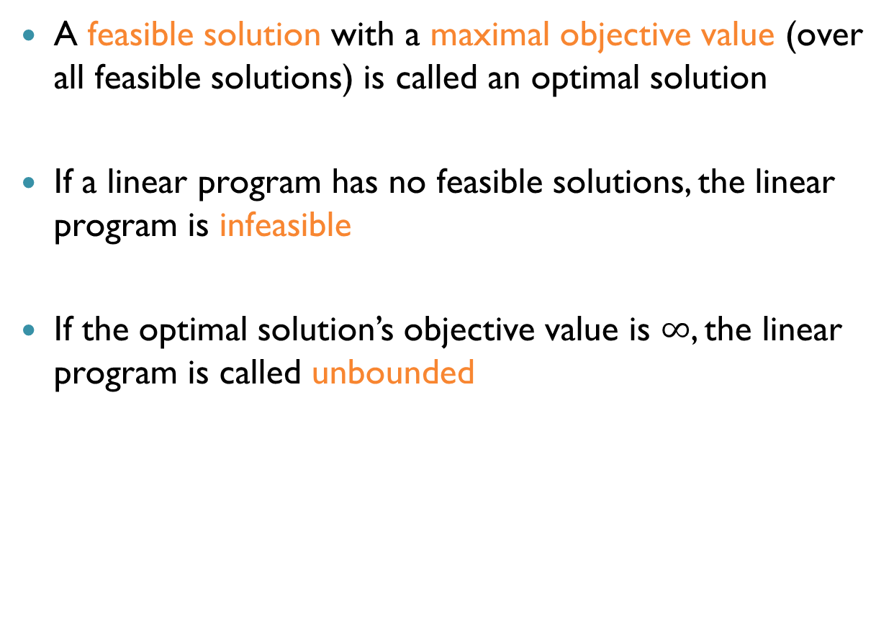
Example and Lingo (cnt’d)
A feasible solution with a maximal objective value (over all feasible solutions) is called an optimal solution
If a linear program has no feasible solutions, the linear program is infeasible
If the optimal solution’s objective value is $∞$, the linear program is called unbounded

Slide 11
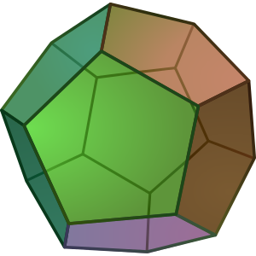
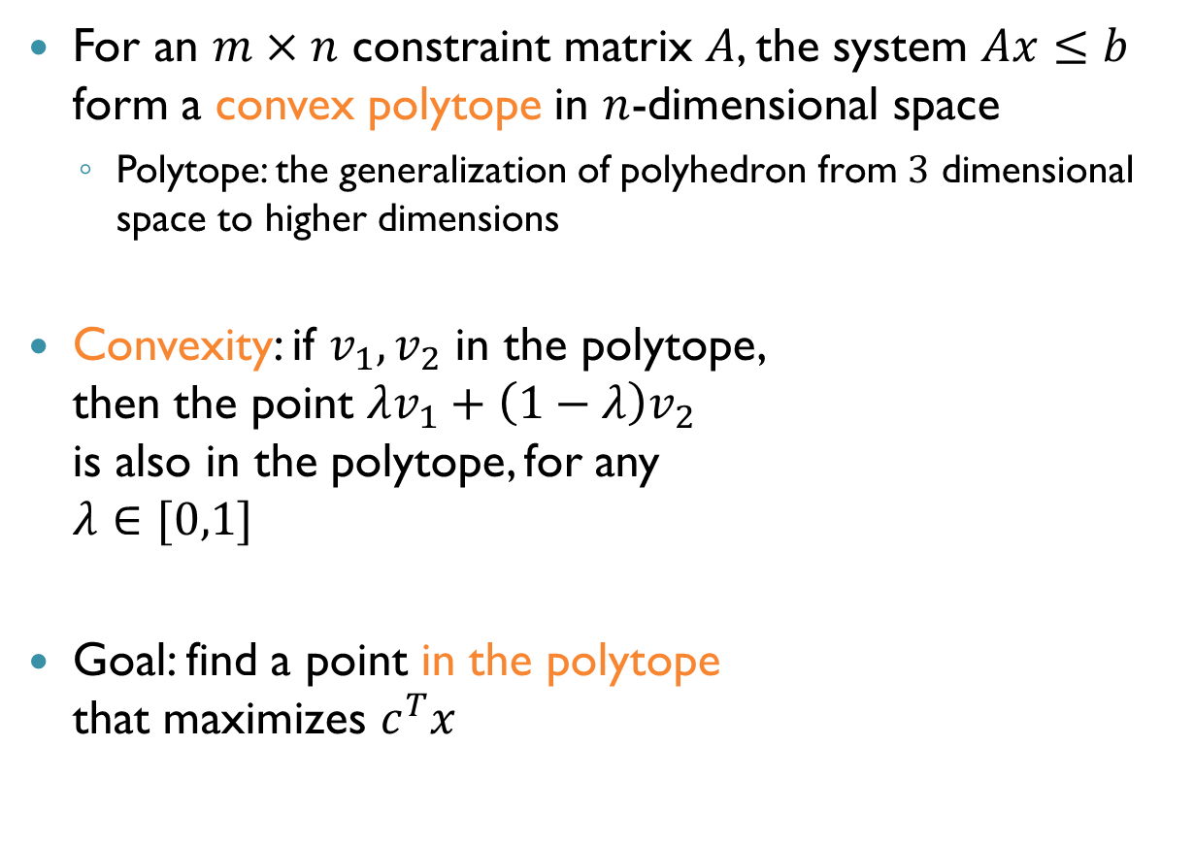
Geometric Interpretation
For an $m×n$ constraint matrix $A$, the system $Ax≤b$ form a convex polytope in $n$-dimensional space
Polytope: the generalization of polyhedron from $3$ dimensional space to higher dimensions
Convexity: if $v_{1},v_{2}$ in the polytope, then the point $λv_{1}+\left(1−λ\right)v_{2}$ is also in the polytope, for any $λ∈[0,1]$
Goal: find a point in the polytope that maximizes $c^{T}x$

Slide 12
Geometric Interpretation (cnt’d)
The feasible solutions are the points in the polytope
The LP is infeasible if the polytope is empty
The LP is unbounded if the polytope is open in the direction of the objective function
The optimal solution for a bounded LP must lie on the exterior boundary of the polytope

Slide 13
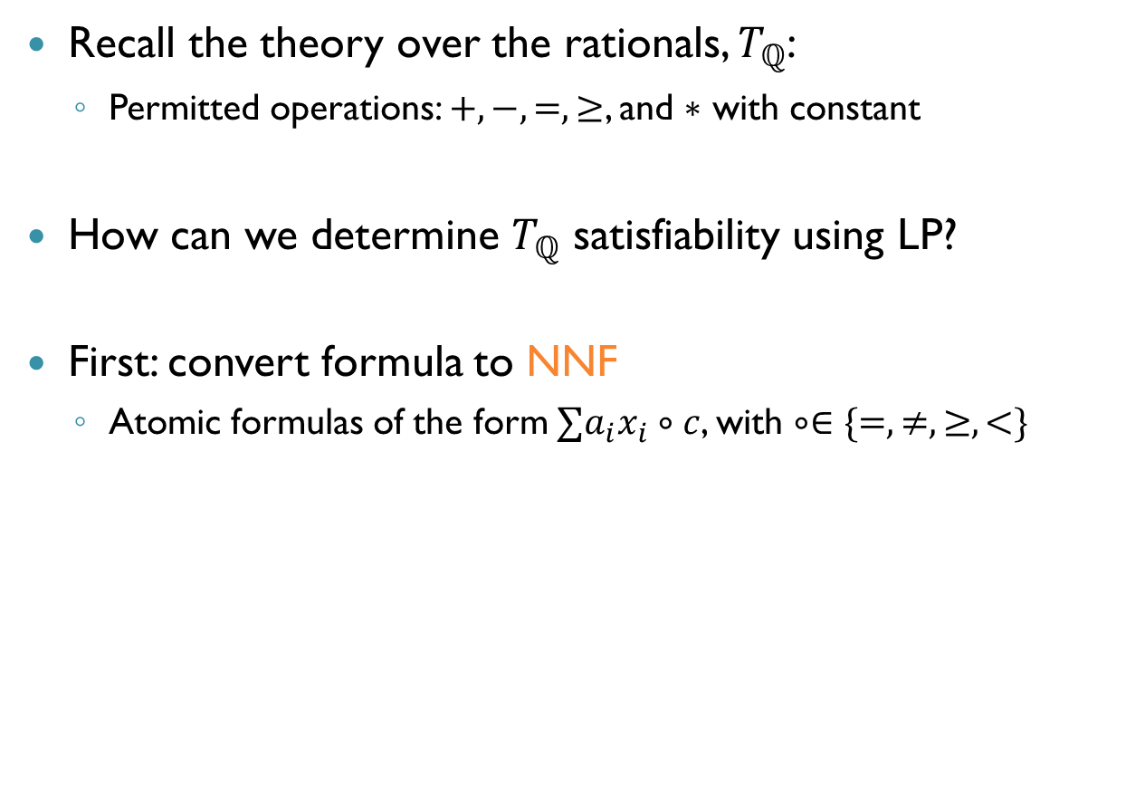

$T_{ℚ}$ as a Linear Program
Recall the theory over the rationals, $T_{ℚ}$:
Permitted operations: $+,−,=,≥$, and $∗$ with constant
How can we determine $T_{ℚ}$ satisfiability using LP?
First: convert formula to NNF
Atomic formulas of the form $∑a_{i}x_{i}∘c$, with $∘∈\{=,≠,≥,<\}$

Slide 14
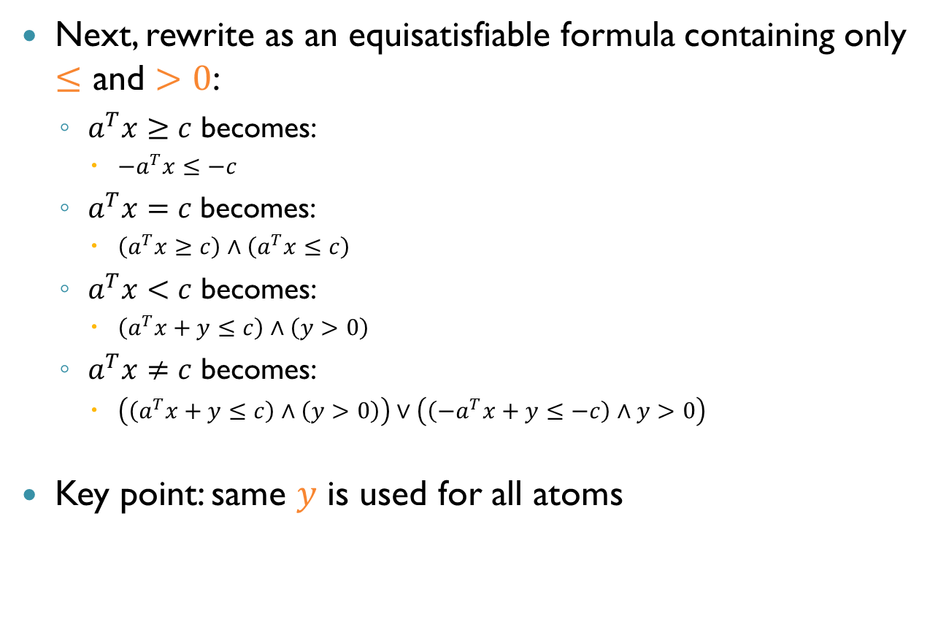

$T_{ℚ}$ as Linear Programs (cnt’d)
Next, rewrite as an equisatisfiable formula containing only $≤$ and $>0$:
$a^{T}x≥c$ becomes:
$−a^{T}x≤−c$
$a^{T}x=c \text{becomes}\text{:}$
$\left(a^{T}x≥c\right)∧\left(a^{T}x≤c\right)$
$a^{T}x<c$ becomes:
$\left(a^{T}x+y≤c\right)∧\left(y>0\right)$
$a^{T}x≠c$ becomes:
$\left(\left(a^{T}x+y≤c\right)∧\left(y>0\right)\right)∨\left(\left({−a}^{T}x+y≤−c\right)∧y>0\right)$
Key point: same $y$ is used for all atoms

Slide 15
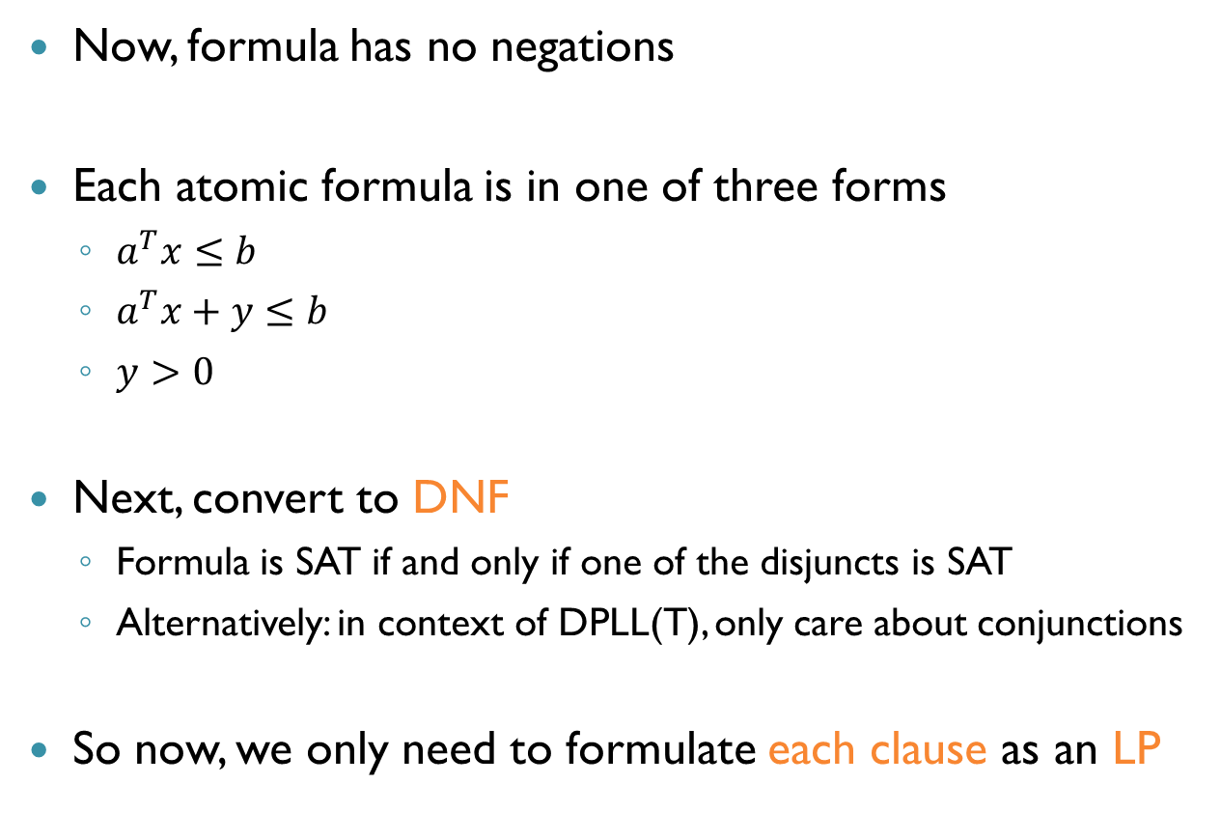
$T_{ℚ}$ as Linear Programs (cnt’d)
Now, formula has no negations
Each atomic formula is in one of three forms
$a^{T}x≤b$
$a^{T}x+y≤b$
$y>0$
Next, convert to DNF
Formula is SAT if and only if one of the disjuncts is SAT
Alternatively: in context of DPLL(T), only care about conjunctions
So now, we only need to formulate each clause as an LP

Slide 16
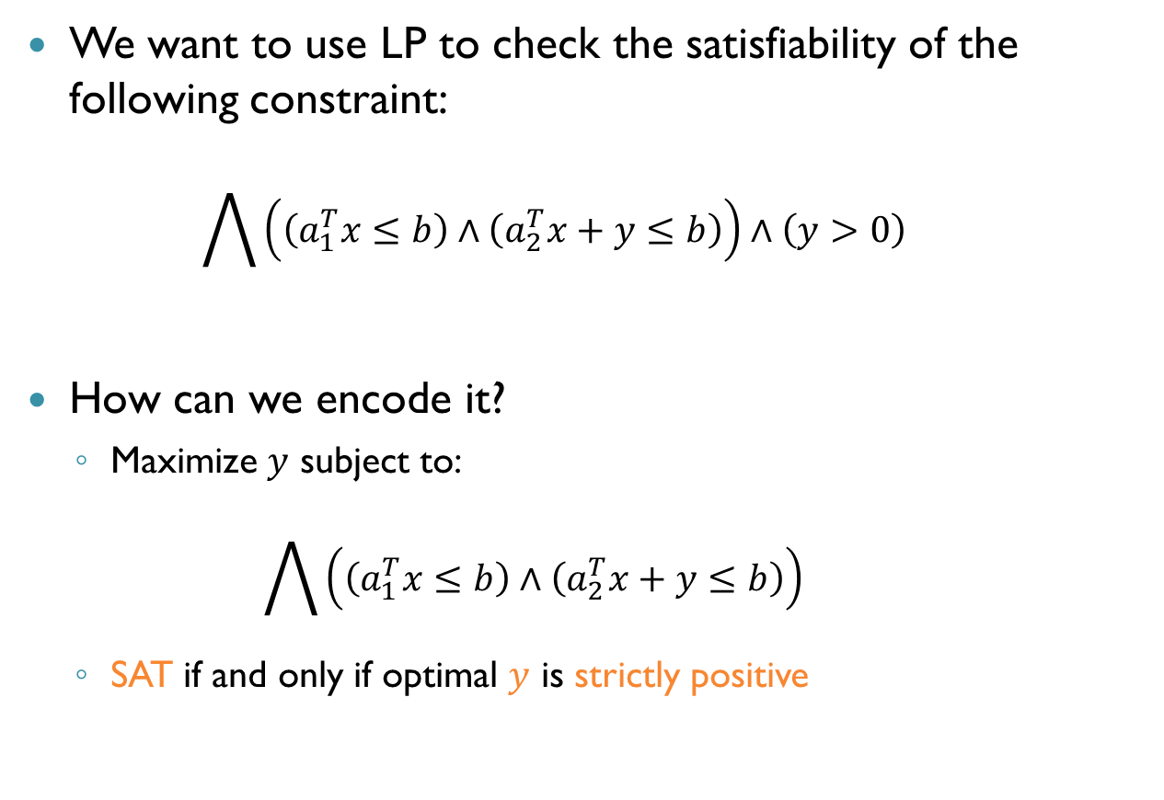

$T_{ℚ}$ as Linear Programs (cnt’d)
We want to use LP to check the satisfiability of the following constraint: $\bigwedge{\left(\left(a_{1}^{T}x≤b\right)∧\left(a_{2}^{T}x+y≤b\right)\right)}∧\left(y>0\right)$
How can we encode it?
Maximize $y$ subject to: $\bigwedge{\left(\left(a_{1}^{T}x≤b\right)∧\left(a_{2}^{T}x+y≤b\right)\right)}$
SAT if and only if optimal $y$ is strictly positive

Slide 17
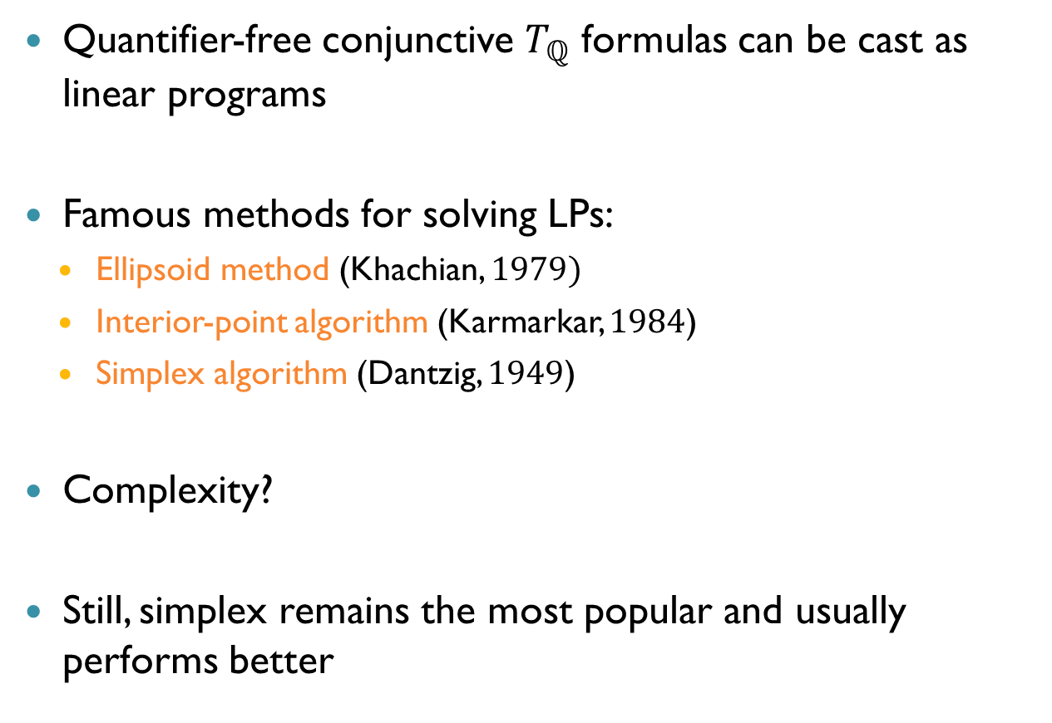
Satisfiability as Linear Programming
Quantifier-free conjunctive $T_{ℚ}$ formulas can be cast as linear programs
Famous methods for solving LPs:
Ellipsoid method (Khachian, $1979)$
Interior-point algorithm (Karmarkar, $1984$)
Simplex algorithm (Dantzig, $1949$)
Complexity?
Still, simplex remains the most popular and usually performs better
Polynomial time
Polynomial time
Exponential time (probably)

Slide 18
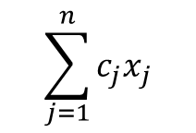


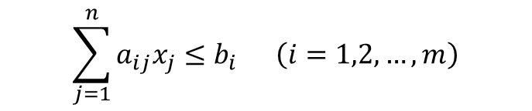
Standard Form
For simplicity, we restrict ourselves to LPs with the following, standard form:
The last $n$ constraints: non-negativity of the $n$ variables
$$\sum_{j=1}^{n}{c_{j}x_{j}}$$
maximize
$$\sum_{j=1}^{n}{a_{ij}x_{j}≤b_{i}} \left(i=1,2,…,m\right)$$
subject to
$$x_{j}≥0 (j=1,2,…, n)$$

Slide 19


Running Example
maximize
$$5x_{1}+4x_{2}+3x_{3}$$
$$2x_{1}+3x_{2}+1x_{3}≤05$$
$$4x_{1}+1x_{2}+2x_{3}≤11 \\ 3x_{1}+4x_{2}+2x_{3}≤08$$
$$x_{1},x_{2},x_{3}≥0$$
subject to

Slide 20

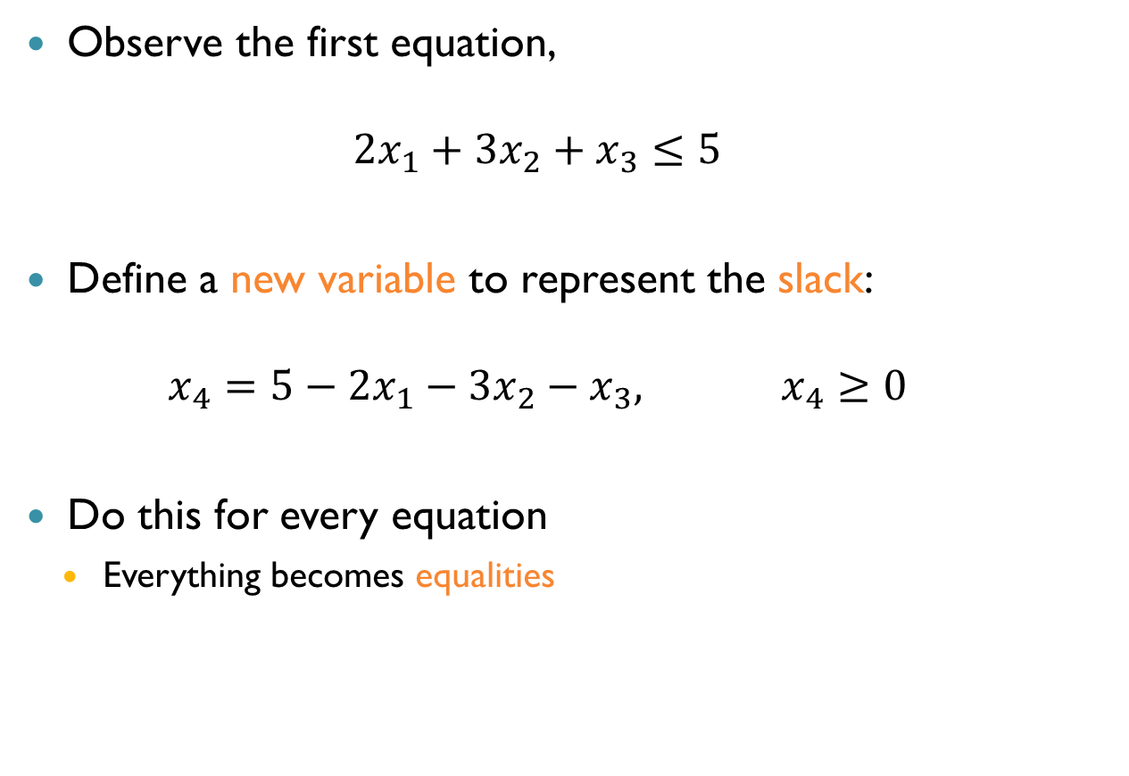

Slack Variables
$$5x_{1}+4x_{2}+3x_{3}$$
$$2x_{1}+3x_{2}+1x_{3}≤05$$
$$4x_{1}+1x_{2}+2x_{3}≤11 \\ 3x_{1}+4x_{2}+2x_{3}≤08$$
$$x_{1},x_{2},x_{3}≥0$$
Observe the first equation, $2x_{1}+3x_{2}+x_{3}≤5$
Define a new variable to represent the slack: $x_{4}=5−2x_{1}−3x_{2}−x_{3}, x_{4}≥0$
Do this for every equation
Everything becomes equalities

Slide 21


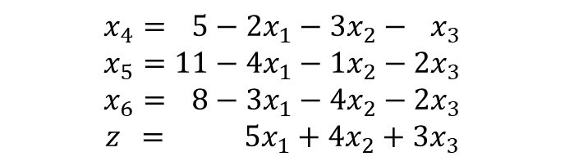

Slack Variables (cnt’d)
Maximize $z$ subject to $x_{1},x_{2},x_{3},x_{4},x_{5},x_{6}≥0$
New variables are called slack variables
New problem is equisatisfiable to the original (delete the slack variables)
Optimal solutions remain optimal for the new problem
$$5x_{1}+4x_{2}+3x_{3}$$
$$2x_{1}+3x_{2}+1x_{3}≤05$$
$$4x_{1}+1x_{2}+2x_{3}≤11 \\ 3x_{1}+4x_{2}+2x_{3}≤08$$
$$x_{1},x_{2},x_{3}≥0$$
$$x_{4}=05−2x_{1}−3x_{2}−1x_{3}$$
$$x_{5}=11−4x_{1}−1x_{2}−2x_{3}$$
$$x_{6}=08−3x_{1}−4x_{2}−2x_{3}$$
$$z_{1}=00+5x_{1}+4x_{2}+3x_{3}$$

Slide 22
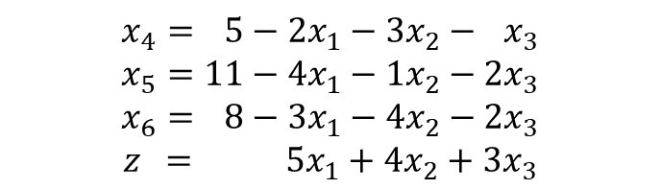
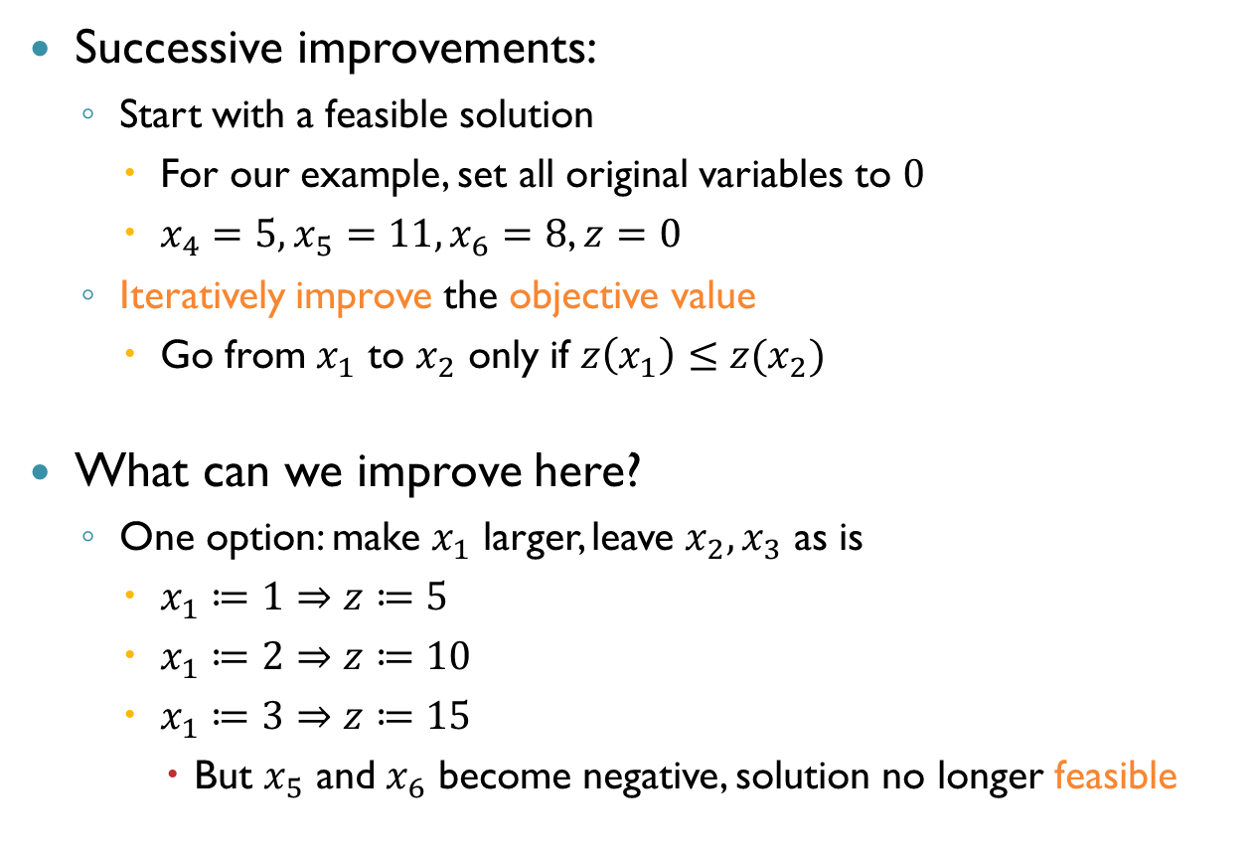
The Simplex Strategy
$$x_{4}=05−2x_{1}−3x_{2}−1x_{3}$$
$$x_{5}=11−4x_{1}−1x_{2}−2x_{3}$$
$$x_{6}=08−3x_{1}−4x_{2}−2x_{3}$$
$$z_{1}=00+5x_{1}+4x_{2}+3x_{3}$$
Successive improvements:
Start with a feasible solution
For our example, set all original variables to $0$
$x_{4}=5,x_{5}=11,x_{6}=8$, $z=0$
Iteratively improve the objective value
Go from $x_{1}$ to $x_{2}$ only if $z\left(x_{1}\right)≤z(x_{2})$
What can we improve here?
One option: make $x_{1}$ larger, leave $x_{2},x_{3}$ as is
$x_{1}≔1⇒z≔5$
$x_{1}≔2⇒z≔10$
$x_{1}≔3⇒z≔15$
But $x_{5}$ and $x_{6}$ become negative, solution no longer feasible

Slide 23
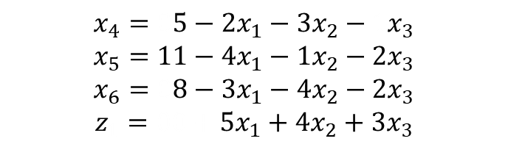
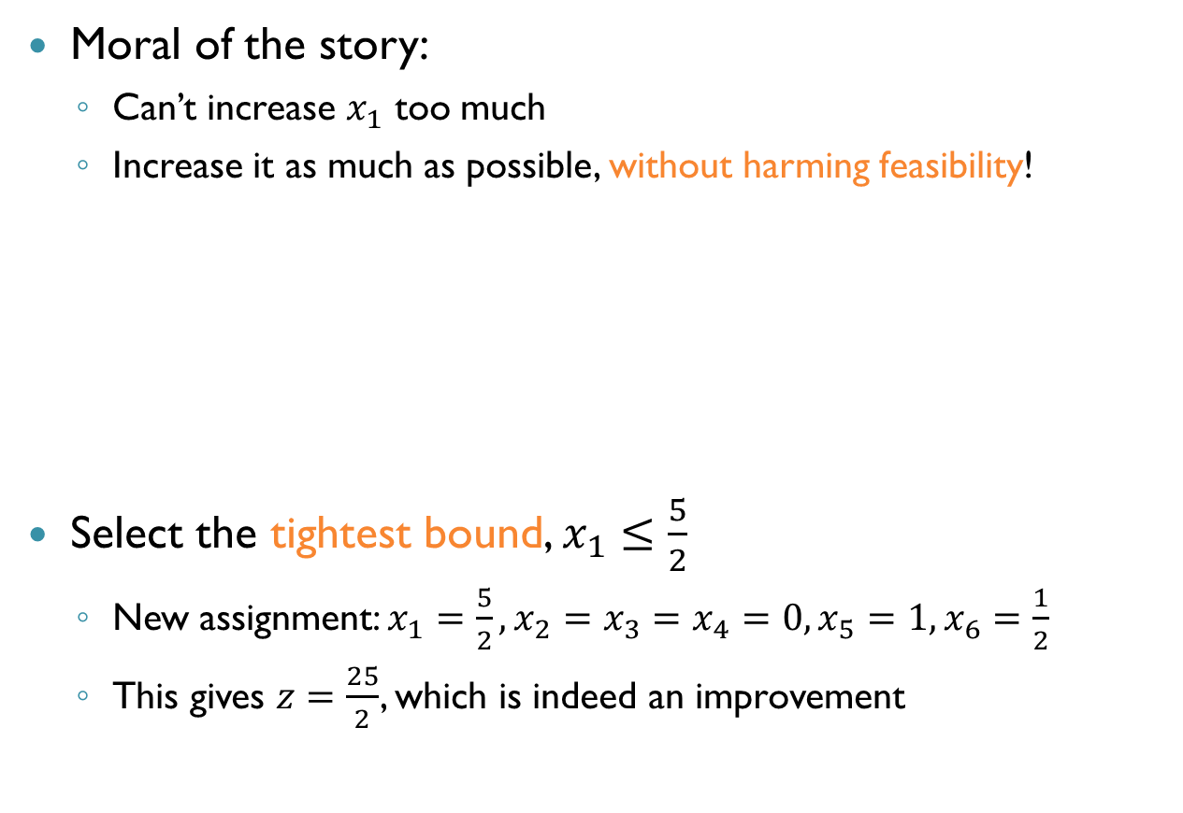

The Simplex Strategy (cnt’d)
Moral of the story:
Can’t increase $x_{1}$ too much
Increase it as much as possible, without harming feasibility!
Select the tightest bound, $x_{1}≤\frac{5}{2}$
New assignment: $x_{1}=\frac{5}{2},x_{2}=x_{3}=x_{4}=0, x_{5}=1,x_{6}=\frac{1}{2}$
This gives $z=\frac{25}{2}$, which is indeed an improvement
$$x_{4}=05−2x_{1}−3x_{2}−1x_{3}$$
$$x_{5}=11−4x_{1}−1x_{2}−2x_{3}$$
$$x_{6}=08−3x_{1}−4x_{2}−2x_{3}$$
$$z_{1}=00+5x_{1}+4x_{2}+3x_{3}$$
$$x_{1}≤\frac{5}{2}, x_{1}≤\frac{11}{4},x_{1}≤\frac{8}{3}$$

Slide 24

The Simplex Strategy (cnt’d)
How do we continue?
For the first iteration, we had:
A feasible solution
An equation system that guided us
After each iteration, equations need to be updated
Express positive variables in terms of zero variables

Slide 25




The Simplex Strategy (cnt’d)
What should we change?
Initially: $x_{1}$ was zero, $x_{4}$ was positive
Now: $x_{4}$ is zero, $x_{1}$ is positive
Isolate $x_{1}$, eliminate from all equations
$$x_{4}=05−2x_{1}−3x_{2}−1x_{3}$$
$$x_{1}=\frac{5}{2}−\frac{3}{2}x_{2}−\frac{1}{2}x_{3}−\frac{1}{2}x_{4}$$
$$x_{1}=\frac{5}{2}−\frac{3}{2}x_{2}−\frac{1}{2}x_{3}−\frac{1}{2}x_{4}$$
$$x_{5}=1+5x_{2}+0x_{3}+2x_{4}$$
$$x_{6}=\frac{1}{2}+\frac{1}{2}x_{2}−\frac{1}{2}x_{3}+\frac{3}{2}x_{4}$$
$$z=\frac{25}{2}−\frac{7}{2}x_{2}+\frac{1}{2}x_{3}−\frac{5}{2}x_{4}$$
$$x_{4}=05−2x_{1}−3x_{2}−1x_{3}$$
$$x_{5}=11−4x_{1}−1x_{2}−2x_{3}$$
$$x_{6}=08−3x_{1}−4x_{2}−2x_{3}$$
$$z_{1}=00+5x_{1}+4x_{2}+3x_{3}$$

Slide 26

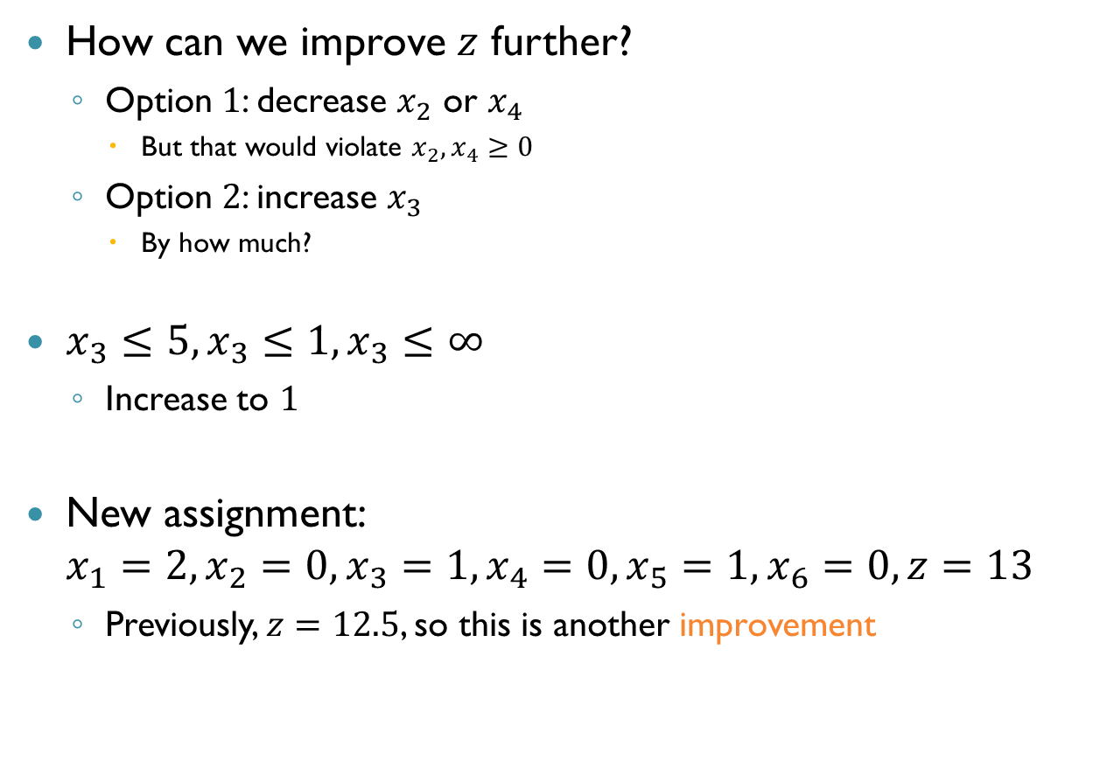
The Simplex Strategy (cnt’d)
How can we improve $z$ further?
Option $1$: decrease $x_{2}$ or $x_{4}$
But that would violate $x_{2},x_{4}≥0$
Option $2$: increase $x_{3}$
By how much?
$x_{3}≤5, x_{3}≤1,x_{3}≤∞$
Increase to $1$
New assignment: $x_{1}=2,x_{2}=0,x_{3}=1, x_{4}=0,x_{5}=1,x_{6}=0,z=13$
Previously, $z=12.5$, so this is another improvement
$$x_{1}=\frac{5}{2}−\frac{3}{2}x_{2}−\frac{1}{2}x_{3}−\frac{1}{2}x_{4}$$
$$x_{5}=1+5x_{2}+0x_{3}+2x_{4}$$
$$x_{6}=\frac{1}{2}+\frac{1}{2}x_{2}−\frac{1}{2}x_{3}+\frac{3}{2}x_{4}$$
$$z=\frac{25}{2}−\frac{7}{2}x_{2}+\frac{1}{2}x_{3}−\frac{5}{2}x_{4}$$

Slide 27


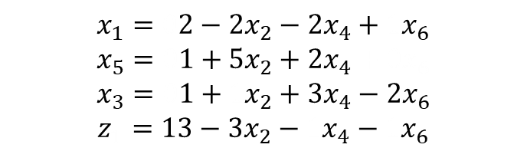
The Simplex Strategy (cnt’d)
As before, we switch $x_{6}$ and $x_{3}$ and eliminate $x_{3}$ from all equations
$$x_{1}=\frac{5}{2}−\frac{3}{2}x_{2}−\frac{1}{2}x_{3}−\frac{1}{2}x_{4}$$
$$x_{5}=1+5x_{2}+0x_{3}+2x_{4}$$
$$x_{6}=\frac{1}{2}+\frac{1}{2}x_{2}−\frac{1}{2}x_{3}+\frac{3}{2}x_{4}$$
$$z=\frac{25}{2}−\frac{7}{2}x_{2}+\frac{1}{2}x_{3}−\frac{5}{2}x_{4}$$
$$x_{1}=02−2x_{2}−2x_{4}+1x_{6}$$
$$x_{5}=01+5x_{2}+2x_{4}+0x_{6}$$
$$x_{3}=01+1x_{2}+3x_{4}−2x_{6}$$
$$z_{1}=13−3x_{2}−1x_{4}−1x_{6}$$

Slide 28
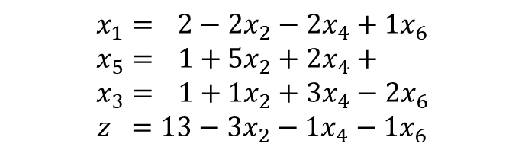
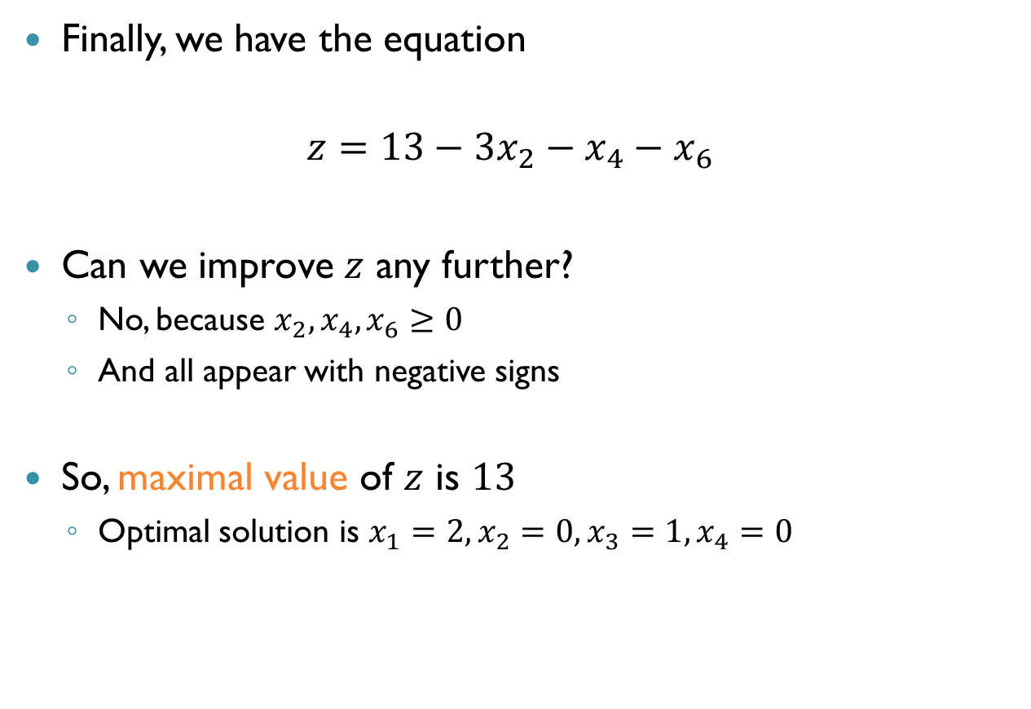
The Simplex Strategy (cnt’d)
Finally, we have the equation
$$z=13−3x_{2}−x_{4}−x_{6}$$
Can we improve $z$ any further?
No, because $x_{2},x_{4},x_{6}≥0$
And all appear with negative signs
So, maximal value of $z$ is $13$
Optimal solution is $x_{1}=2,x_{2}=0,x_{3}=1,x_{4}=0$
$$x_{1}=02−2x_{2}−2x_{4}+1x_{6}$$
$$x_{5}=01+5x_{2}+2x_{4}+0x_{6}$$
$$x_{3}=01+1x_{2}+3x_{4}−2x_{6}$$
$$z_{1}=13−3x_{2}−1x_{4}−1x_{6}$$

Slide 29

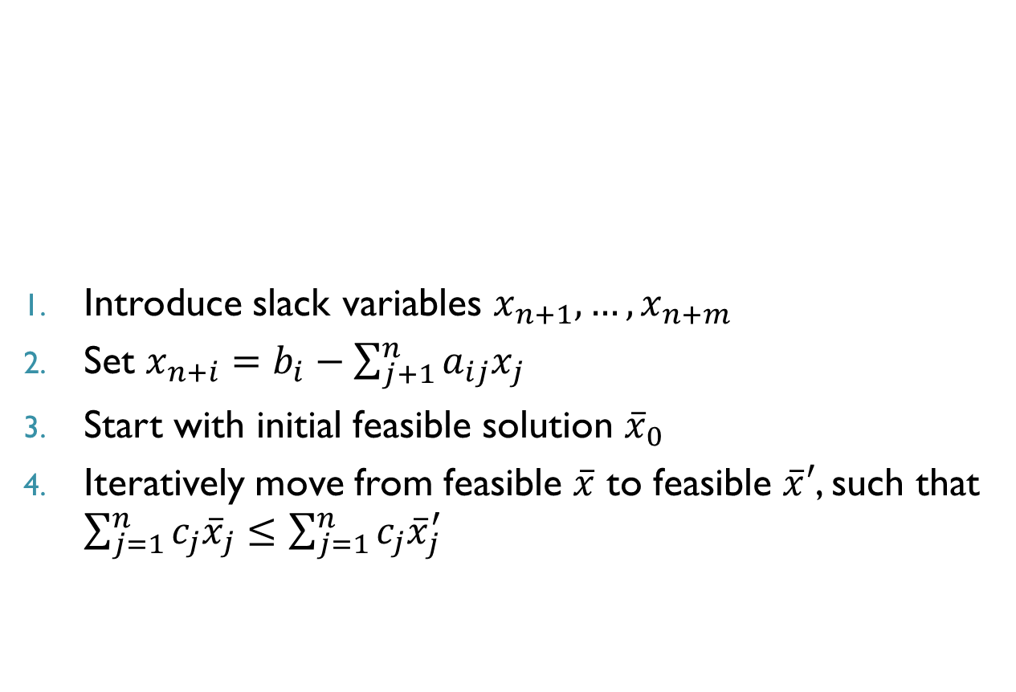
Recap
$$\sum_{j=1}^{n}{c_{j}x_{j} (=z)}$$
maximize
Introduce slack variables $x_{n+1},…, x_{n+m}$
Set $x_{n+i}=b_{i}−\sum_{j+1}^{n}{a_{ij}x_{j}}$
Start with initial feasible solution ${\overline{x}}_{0}$
Iteratively move from feasible $\overline{x}$ to feasible $\overline{x}′$, such that $\sum_{j=1}^{n}{c_{j}{\overline{x}}_{j}}≤\sum_{j=1}^{n}{c_{j}{\overline{x}}_{j}^{′}}$
$$\sum_{j=1}^{n}{a_{ij}x_{j}≤b_{i}} \left(i=1,2,…,m\right)$$
subject to
$$x_{j}≥0 (j=1,2,…, n)$$

Slide 30
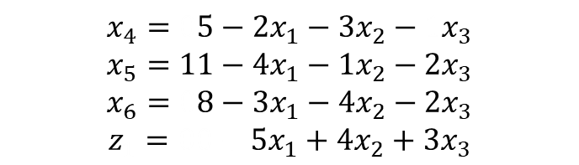
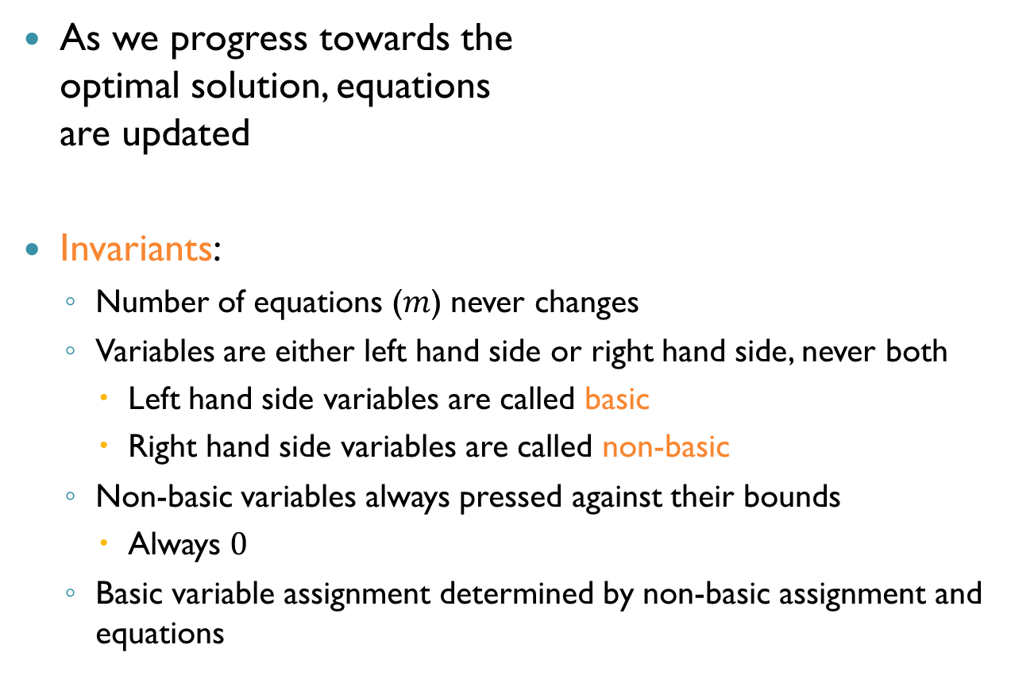
Updating the Equations
As we progress towards the optimal solution, equations are updated
Invariants:
Number of equations ($m$) never changes
Variables are either left hand side or right hand side, never both
Left hand side variables are called basic
Right hand side variables are called non-basic
Non-basic variables always pressed against their bounds
Always $0$
Basic variable assignment determined by non-basic assignment and equations
$$x_{4}=05−2x_{1}−3x_{2}−1x_{3}$$
$$x_{5}=11−4x_{1}−1x_{2}−2x_{3}$$
$$x_{6}=08−3x_{1}−4x_{2}−2x_{3}$$
$$z_{1}=00+5x_{1}+4x_{2}+3x_{3}$$

Slide 31
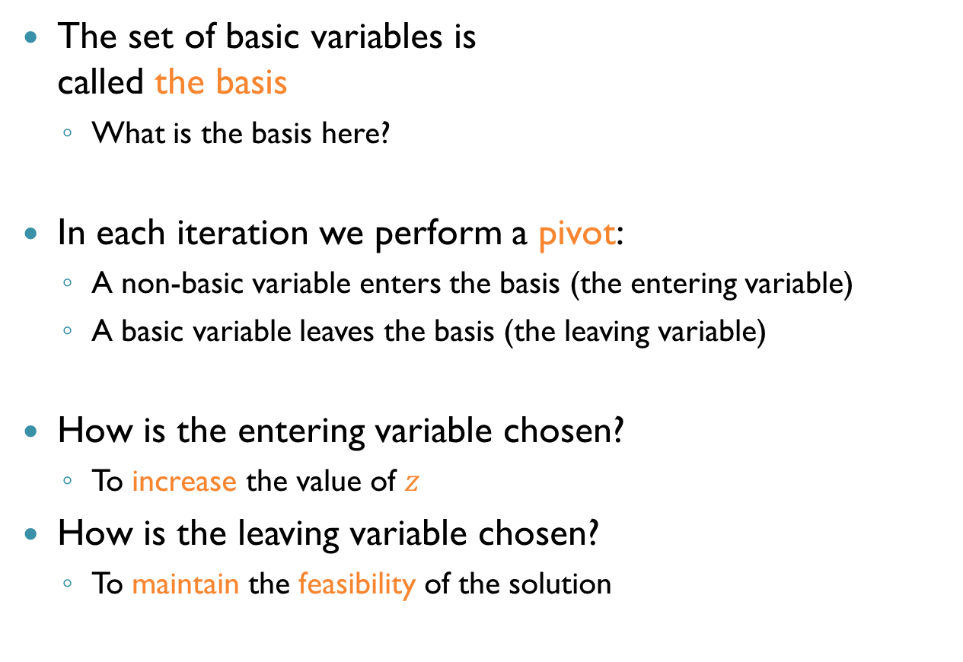
Updating the Equations (cnt’d)
The set of basic variables is called the basis
What is the basis here?
In each iteration we perform a pivot:
A non-basic variable enters the basis (the entering variable)
A basic variable leaves the basis (the leaving variable)
How is the entering variable chosen?
To increase the value of $z$
How is the leaving variable chosen?
To maintain the feasibility of the solution
$$x_{4}=05−2x_{1}−3x_{2}−1x_{3}$$
$$x_{5}=11−4x_{1}−1x_{2}−2x_{3}$$
$$x_{6}=08−3x_{1}−4x_{2}−2x_{3}$$
$$z_{1}=00+5x_{1}+4x_{2}+3x_{3}$$

Slide 32




Another Example
What is the feasible solution described here?
$x_{1}=x_{2}=x_{3}=0,x_{4}=3,x_{5}=2,x_{6}=4,x_{7}=2 (z=0)$
This is implicit
maximize
$$5x_{1}+5x_{2}+3x_{3}$$
$$x_{4}=3−1x_{1}−3x_{2}−1x_{3}$$
$$x_{5}=2+1x_{1}−0x_{2}−3x_{3}$$
$$x_{6}=4−2x_{1}+1x_{2}−2x_{3}$$
$$x_{7}=2−2x_{1}−3x_{2}+1x_{3}$$
$$z_{1}=0+5x_{1}+5x_{2}+3x_{3}$$
$$1x_{1}+3x_{2}+1x_{3}≤3$$
$$−x_{1}+1x_{2}+3x_{3}≤2 \\ 2x_{1}−1x_{2}+2x_{3}≤4 \\ 2x_{1}+3x_{2}−1x_{3}≤2$$
$$x_{1},x_{2},x_{3}≥0$$
subject to

Slide 33

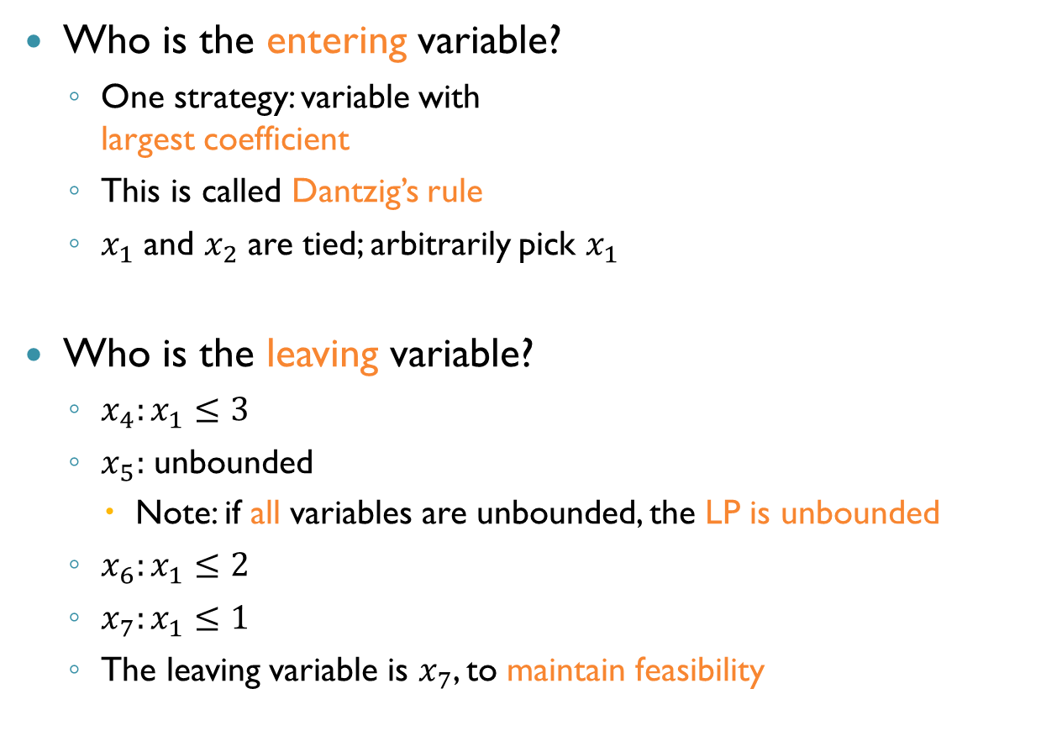
Another Example (cnt’d)
Who is the entering variable?
One strategy: variable with largest coefficient
This is called Dantzig’s rule
$x_{1}$ and $x_{2}$ are tied; arbitrarily pick $x_{1}$
Who is the leaving variable?
$x_{4}:x_{1}≤3$
$x_{5}:$ unbounded
Note: if all variables are unbounded, the LP is unbounded
$x_{6}:x_{1}≤2$
$x_{7}:x_{1}≤1$
The leaving variable is $x_{7}$, to maintain feasibility
$$x_{4}=3−1x_{1}−3x_{2}−1x_{3}$$
$$x_{5}=2+1x_{1}−0x_{2}−3x_{3}$$
$$x_{6}=4−2x_{1}+1x_{2}−2x_{3}$$
$$x_{7}=2−2x_{1}−3x_{2}+1x_{3}$$
$$z_{1}=0+5x_{1}+5x_{2}+3x_{3}$$

Slide 34



Another Example (cnt’d)
Value of $z$ increased to $5$
This concludes the first iteration of simplex
$$x_{1}=1−\frac{3}{2}x_{2}+\frac{1}{2}x_{3}−\frac{1}{2}x_{7}$$
$$x_{4}=2−\frac{3}{2}x_{2}−\frac{3}{2}x_{3}+\frac{1}{2}x_{7}$$
$$x_{5}=3−\frac{3}{2}x_{2}−\frac{5}{2}x_{3}−\frac{1}{2}x_{7}$$
$$x_{6}=2+4x_{2}−3x_{3}+1x_{7}$$
$$z=5−\frac{5}{2}x_{2}+\frac{11}{2}x_{3}−\frac{5}{2}x_{7}$$
$$x_{4}=3−1x_{1}−3x_{2}−1x_{3}$$
$$x_{5}=2+1x_{1}−0x_{2}−3x_{3}$$
$$x_{6}=4−2x_{1}+1x_{2}−2x_{3}$$
$$x_{7}=2−2x_{1}−3x_{2}+1x_{3}$$
$$z_{1}=0+5x_{1}+5x_{2}+3x_{3}$$

Slide 35



Another Example (cnt’d)
$$x_{1}=1−\frac{3}{2}x_{2}+\frac{1}{2}x_{3}−\frac{1}{2}x_{7}$$
$$x_{4}=2−\frac{3}{2}x_{2}−\frac{3}{2}x_{3}+\frac{1}{2}x_{7}$$
$$x_{5}=3−\frac{3}{2}x_{2}−\frac{5}{2}x_{3}−\frac{1}{2}x_{7}$$
$$x_{6}=2+4x_{2}−3x_{3}+1x_{7}$$
$$z=5−\frac{5}{2}x_{2}+\frac{11}{2}x_{3}−\frac{5}{2}x_{7}$$
Entering variable:
$x_{3}$
Leaving variable:
$x_{6}$
$$x_{3}=\frac{2}{3}+\frac{4}{3}x_{2}+\frac{1}{3}x_{7}−\frac{1}{3}x_{6}$$
$$x_{1}=\frac{4}{3}−\frac{5}{6}x_{2}−\frac{1}{3}x_{7}−\frac{1}{6}x_{6}$$
$$x_{4}=1−\frac{7}{2}x_{2}+0x_{7}+\frac{1}{2}x_{6}$$
$$x_{5}=\frac{4}{3}−\frac{29}{6}x_{2}−\frac{4}{3}x_{7}+\frac{5}{6}x_{6}$$
$$z=\frac{26}{3}+\frac{29}{6}x_{2}−\frac{2}{3}x_{7}−\frac{11}{6}x_{6}$$

Slide 36



Another Example (cnt’d)
Entering variable:
$x_{2}$
Leaving variable:
$x_{5}$
$$x_{3}=\frac{2}{3}+\frac{4}{3}x_{2}+\frac{1}{3}x_{7}−\frac{1}{3}x_{6}$$
$$x_{1}=\frac{4}{3}−\frac{5}{6}x_{2}−\frac{1}{3}x_{7}−\frac{1}{6}x_{6}$$
$$x_{4}=1−\frac{7}{2}x_{2}+0x_{7}+\frac{1}{2}x_{6}$$
$$x_{5}=\frac{4}{3}−\frac{29}{6}x_{2}−\frac{4}{3}x_{7}+\frac{5}{6}x_{6}$$
$$z=\frac{26}{3}+\frac{29}{6}x_{2}−\frac{2}{3}x_{7}−\frac{11}{6}x_{6}$$
$$x_{2}=\frac{8}{29}−\frac{8}{29}x_{7}+\frac{5}{29}x_{6}−\frac{6}{29}x_{5}$$
$$x_{3}=\frac{30}{29}−\frac{1}{29}x_{7}−\frac{3}{29}x_{6}−\frac{8}{29}x_{5}$$
$$x_{1}=\frac{32}{29}−\frac{3}{29}x_{7}−\frac{9}{29}x_{6}+\frac{5}{29}x_{5}$$
$$x_{4}=\frac{1}{29}+\frac{28}{29}x_{7}−\frac{3}{29}x_{6}+\frac{21}{29}x_{5}$$
$$z=10−2x_{7}−1x_{6}−1x_{5}$$

Slide 37


Another Example (cnt’d)
Entering variable:
We are done!
Solution: $x_{1}=\frac{32}{29},x_{2}=\frac{8}{29},x_{3}=\frac{30}{29}$ $z=10$
Because of how pivoting is performed, this solution is also a feasible solution of the original system
$$x_{2}=\frac{8}{29}−\frac{8}{29}x_{7}+\frac{5}{29}x_{6}−\frac{6}{29}x_{5}$$
$$x_{3}=\frac{30}{29}−\frac{1}{29}x_{7}−\frac{3}{29}x_{6}−\frac{8}{29}x_{5}$$
$$x_{1}=\frac{32}{29}−\frac{3}{29}x_{7}−\frac{9}{29}x_{6}+\frac{5}{29}x_{5}$$
$$x_{4}=\frac{1}{29}+\frac{28}{29}x_{7}−\frac{3}{29}x_{6}+\frac{21}{29}x_{5}$$
$$z=10−2x_{7}−1x_{6}−1x_{5}$$

Slide 38



Tableau
$$x_{4}=05−2x_{1}−3x_{2}−1x_{3}$$
$$x_{5}=11−4x_{1}−1x_{2}−2x_{3}$$
$$x_{6}=08−3x_{1}−4x_{2}−2x_{3}$$
$$z_{1}=00+5x_{1}+4x_{2}+3x_{3}$$
This format is called a dictionary
A more popular version is called a tableau:
And in matrix form:
$$−z+2x_{1}+3x_{2}+1x_{3}+1x_{4}+0x_{5}+0x_{6}=05$$
$$−z+4x_{1}+1x_{2}+2x_{3}+1x_{4}+0x_{5}+0x_{6}=11$$
$$−z+3x_{1}+4x_{2}+2x_{3}+1x_{4}+0x_{5}+1x_{6}=08$$
$$−z+5x_{1}+4x_{2}+3x_{3}+1x_{4}+0x_{5}+0x_{6}=00$$
$$\left[\begin{matrix}2 & 3 & 1 & 1 & 0 & 0 & 5 \\ 4 & 1 & 2 & 0 & 1 & 0 & 11 \\ 3 & 4 & 2 & 0 & 0 & 1 & 8 \\ 5 & 4 & 3 & 0 & 0 & 0 & 0\end{matrix}\right]$$

Slide 39


Pivoting with a Tableau
Examine last row
Except last column, which is the current $z$
If all entries are $0$ or negative, stop
The solution is optimal
Else, pick the column of the largest entry
This is Danzig’s rule
$$\left[\begin{matrix}2 & 3 & 1 & 1 & 0 & 0 & 5 \\ 4 & 1 & 2 & 0 & 1 & 0 & 11 \\ 3 & 4 & 2 & 0 & 0 & 1 & 8 \\ 5 & 4 & 3 & 0 & 0 & 0 & 0\end{matrix}\right]$$

Slide 40

Pivoting with a Tableau (cnt’d)
For each positive entry $r$ in this column, look up entry $s$ in the rightmost column
The value $s / r$ is the ratio constraint of this row
The row with the smallest ratio constraint indicates the leaving variable
What is the pivot row in our example? What is the ratio?
First row, with ratio $5 / 2$
$$\left[\begin{matrix}2 & 3 & 1 & 1 & 0 & 0 & 5 \\ 4 & 1 & 2 & 0 & 1 & 0 & 11 \\ 3 & 4 & 2 & 0 & 0 & 1 & 8 \\ 5 & 4 & 3 & 0 & 0 & 0 & 0\end{matrix}\right]$$

Slide 41

Pivoting with a Tableau (cnt’d)
The number at the intersection is the pivot number
Divide every entry in the pivot row by the pivot number
$$\left[\begin{matrix}2 & 3 & 1 & 1 & 0 & 0 & 5 \\ 4 & 1 & 2 & 0 & 1 & 0 & 11 \\ 3 & 4 & 2 & 0 & 0 & 1 & 8 \\ 5 & 4 & 3 & 0 & 0 & 0 & 0\end{matrix}\right]$$
$$\left[\begin{matrix}1 & 3/2 & 1/2 & 1/2 & 0 & 0 & 5/2 \\ 4 & 1 & 2 & 0 & 1 & 0 & 11 \\ 3 & 4 & 2 & 0 & 0 & 1 & 8 \\ 5 & 4 & 3 & 0 & 0 & 0 & 0\end{matrix}\right]$$

Slide 42


Pivoting with a Tableau (cnt’d)
Subtract a multiple of the pivot row from the other rows of the column to zero-out all other elements
And this is the tableau after this iteration
$$\left[\begin{matrix}1 & 3/2 & 1/2 & 1/2 & 0 & 0 & 5/2 \\ 4 & 1 & 2 & 0 & 1 & 0 & 11 \\ 3 & 4 & 2 & 0 & 0 & 1 & 8 \\ 5 & 4 & 3 & 0 & 0 & 0 & 0\end{matrix}\right]$$
$$\left[\begin{matrix}1 & 3/2 & 1/2 & 1/2 & 0 & 0 & 5/2 \\ 0 & −5 & 0 & −2 & 1 & 0 & 1 \\ 0 & −1/2 & 1/2 & −3/2 & 0 & 1 & 1/2 \\ 0 & −7/2 & 1/2 & −5/2 & 0 & 0 & −25/2\end{matrix}\right]$$

Slide 43
Tableaus and Dictionaries
Which format is easier to understand?
For humans: dictionaries
In a typical simplex execution you can expect many thousands of pivots
Matrix notation (tableaus) much more efficient
Dictionaries not used in practice
In fact, even tableaus are not efficient enough!
Instead, use the revised simplex method

Slide 44

Some Pitfalls
Possible problems in simplex as described so far:
Initialization
How do we get hold an initial feasible dictionary?
Termination
Can we encounter an endless sequence of dictionaries without reaching an optimal $z$?

Slide 45

Pitfalls: Initialization
Original equation: $\sum_{j=1}^{n}{a_{ij}x_{j}≤b_{i}}$
With slack variable: $x_{n+i}=b_{i}−\sum_{j=1}^{n}{a_{ij}x_{j}}$
Initial solution: $x_{1},…, x_{n}=0$
When is this feasible?
If and only if all $b_{i}$ are non-negative
What can we do for negative $b_{i}$s?

Slide 46





Pitfalls: Initialization (cnt’d)
The solution: switch to an auxiliary problem
$$\sum_{j=1}^{n}{c_{j}x_{j}}$$
maximize
$$\sum_{j=1}^{n}{a_{ij}x_{j}≤b_{i}} \left(i=1,2,…,m\right)$$
subject to
$$x_{j}≥0 (j=1,2,…, n)$$
minimize
$$x_{0}$$
$$\sum_{j=1}^{n}{a_{ij}x_{j}−x_{0}≤b_{i}} \left(i=1,2,…,m\right)$$
subject to
$$x_{j}≥0 (j=0,1,2,…, n)$$

Slide 47




Pitfalls: Initialization (cnt’d)
For the auxiliary problem, a feasible solution is easy to find: set $x_{1},…, x_{n}=0$, and make $x_{0}$ very large
Initially $x_{0}$ will be $0$, and the solution will be infeasible
This is fixed by a single pivot
$x_{0}$ enters the basis
Row with the most negative $b_{i}$ determines the leaving variable
minimize
$$x_{0}$$
$$\sum_{j=1}^{n}{a_{ij}x_{j}−x_{0}≤b_{i}} \left(i=1,2,…,m\right)$$
subject to
$$x_{j}≥0 (j=0,1,2,…, n)$$

Slide 48

Pitfalls: Initialization (cnt’d)
Original problem has a solution if and only if optimal solution for the auxiliary problem has $x_{0}=0$
How do we go back to the original problem?
Look at the last dictionary of the auxiliary problem
Can prove: $x_{0}$ is not basic
Perform pivoting on the original problem to obtain same dictionary (i.e., same set of basic variables)
Can prove: this dictionary will be feasible
Then, continue normally

Slide 49

The Two Steps of Simplex
Simplex traditionally divided into two steps:
Find a feasible solution
Optimize the objective function
But behind the scenes, there is only step #$2$…
We will always assume a feasible solution has already been found

Slide 50

Pitfalls: Termination
Recall: the goal of every iteration is to increase $z$
We swap a non-basic variable with a basic variable
The non-basic (entering) variable has a positive coefficient in the objective function
If no such variable exists, the objective function is optimal and we can stop
The leaving variable is the one imposing the tightest constraint
An iteration will never make $z$ worse
When might we not converge to the optimal $z$?

Slide 51

Pitfalls: Termination (cnt’d)
Two possible cases for non-termination:
The value of $z$ always eventually increases, but converges to a value that is never reached
E.g., $z_{i}=\sum_{i=1}^{n}{\frac{1}{i^{2}}}$
At some point, $z$ stops increasing
It turns out that case #$1$ can never occur
So we only need to worry about case #2

Slide 52

Pitfalls: Termination (cnt’d)
Theorem: if simplex fails to terminate, it must be cycling
Cycling: same dictionary is repeated infinitely often
Proof overview:
Finitely many bases (pick $m$ out of $m+n$ variables)
$(\begin{matrix}m+n \\ m\end{matrix})$
A base uniquely defines the dictionary
Hence, finitely many values of $z$
So, if simplex doesn’t terminate, at some point $z$ has to stop increasing

Slide 53

Degenerate Pivots
Consider the following case: $x_{1}={−x}_{2}+3x_{3}$ $z=5x_{2}−x_{3}+4x_{4}$
Dantzig’s rule: pick $x_{2}$ as the entering variable
Leaving variable is $x_{1}$
Ratio constraint is $0$!
Value of $z$ doesn’t change after this iteration
This is called a degenerate pivot

Slide 54
Degenerate Pivots (cnt’d)
Endless sequences of degenerate pivots can occur
Same bases visited infinitely often
This is very rare in practice
Preprocessing the equations can reduce the chances
Still, what can we do?
There exist variable selection strategies that guarantee termination!

Slide 55

Bland’s Rule
R. G. Bland ($1977$): the simplex method terminates as long as the entering and leaving variables are selected by the smallest-subscript rule in each iteration
Example:
$z=−5x_{1}−3x_{2}+4x_{3}+40x_{4}$
The entering variable is:
$x_{3}$
Leaving variable: smallest ratio rule
In case of ties, select the variable with the smaller subscript

Slide 56
Which Strategy is Best?
Bland’s rule: guarantees termination
Dantzig’s rule: converges faster
Which do you think modern solvers use?
Neither!
There are more sophisticated heuristics
Devex, Steepest Edge
Worst case: if cycling is detected, can switch to Bland’s rule for a while

Slide 57
The Complexity of Simplex
The variant of simplex depends on the selection strategy
Every common strategy (Dantzig’s, Bland’s) has worse-case exponential time
Families of LPs are known that are hard to solve using each strategy
Whether there exists a strategy that gives worst-case polynomial time is an open question

Slide 58

Summary
The Simplex method is an efficient way for solving linear programs
Can serve as a decision procedure for $T_{ℚ}$
Find a feasible solution, then optimize it
Performance and termination depend on the variable selection strategy
Next time: the revised simplex method

